Slide 1
Serial Peripheral Interface (SPI)
By :- AKASH KUMAR GUPTA
KASURA TECHNOLOGIES PRIVATE LIMITED

Slide 2
INTRODUCTION
The Serial Peripheral Interface (SPI) is a synchronous serial communication interface specification used for short distance communication.
The interface was developed by Motorola in the mid-1980s.
SPI devices communicate in full duplex mode using a master-slave architecture with a single master.
Multiple slave-devices are supported through selection with individual slave select (SS), sometimes called chip select (CS), lines

Slide 3
WHY NOT ASYNCHRONOUS ?
The common serial port, such as UART, is called “asynchronous” because there is no control over when data is sent or any guarantee that both sides are running at precisely the same rate.
There can be an issue when two systems with slightly different clocks try to communicate with each other.
To mitigate this issue, asynchronous serial connections add extra start and stop bits to each byte, so as to help the receiver sync up to data as it arrives.
Asynchronous serial works just fine, but has a lot of overhead in both the extra start and stop bits sent with every byte the complex hardware required to send and receive data if both sides aren’t set to the same speed, the received data will be garbage.

Slide 4
How is synchronous beneficial?
A “synchronous” data bus uses separate lines for data and clock that keeps both sides in perfect sync.
The clock is an oscillating signal that tells the receiver exactly when to sample the bits on the data line. This could be the rising (low to high) or falling (high to low) edge of the clock signal; the datasheet will specify which one to use.
When the receiver detects that edge, it will immediately look at the data line to read the next bit.

Slide 5
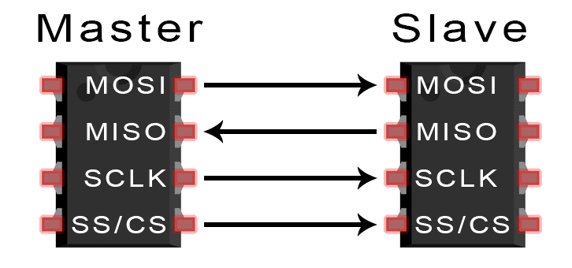
Serial Peripheral Interface (SPI)

Slide 6
THE SPI PROTOCOL - BASICS
The SPI bus can operate with a single master device and with one or more slave devices.
One unique feature of SPI is that data can be transferred without interruption.
Any number of bits can be sent or received in a continuous stream.
With I2C and UART, data is sent in packets, limited to a specific number of bits.
Start and stop conditions define the beginning and end of each packet, so the data is interrupted during transmission.

Slide 7
THE SPI PROTOCOL – BASICS(contd..)
Devices communicating via SPI are in a master slave relationship.
In SPI, only one side generates the clock signal.
There is always only one master but there can be multiple slaves.
The master is the controlling device (usually a microcontroller), while the slave (usually a sensor, display, or memory chip) takes instruction from the master.

Slide 8
SPI INTERFACE
SCLK: Serial Clock (output from master).
MOSI: Master Output Slave Input (data output from master).
MISO: Master Input Slave Output, or Master In Slave Out (data output from slave).
SS: Slave Select (often active low, output from master).

Slide 9
SPI INTERFACE - SCLK
SPI is a synchronous communication protocol.
The clock signal synchronizes the output of data bits from the master with the sampling of bits by the slave.
One bit of data is transferred in each clock cycle, so the speed of data transfer is determined by the frequency of the clock signal.
SPI communication is always initiated by the master since the master configures and generates the clock signal.

Slide 10
SPI INTERFACE – SLAVE SELECT
The master can choose which slave it wants to communicate to by setting the slave’s CS/SS line to a low voltage level.
In the idle, non-transmitting state, the slave select line is kept at a high voltage level.
Multiple CS/SS pins may be available on the master, which allows for multiple slaves to be wired in parallel.
If only one CS/SS pin is present, multiple slaves can be wired to the master by daisy-chaining.

Slide 11
SPI INTERFACE – MULTIPLE SLAVE
Multiple CS/SS pins are available on the master.
Only one CS/SS pin is present, multiple slaves are wired to the master by daisy-chaining.

Slide 12
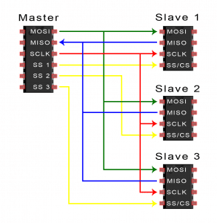
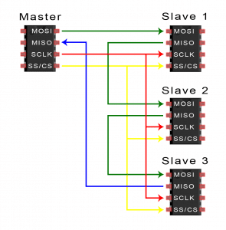

Slide 13
SPI - PROTOCOL
To begin communication, the bus master configures the clock, using a frequency supported by the slave device, typically up to a few MHz.
The master then selects the slave device with a logic level 0 on the select line.
If a waiting period is required, such as for an analog to-digital conversion, the master must wait for at least that period of time before issuing clock cycles.
During each SPI clock cycle, a full duplex data transmission occurs.
The master sends a bit on the MOSI line and the slave reads it, while the slave sends a bit on the MISO line and the master reads it.

Slide 14
DATA TRANSMISSION - SPI

Slide 15
DATA TRANSMISSION – SPI (contd..)
Transmissions normally involve two shift registers of some given word size ( may be 8eight bits), one in the master and one in the slave.
They are connected in a virtual ring topology.
Data is usually shifted out with the most-significant bit first. On the clock edge, both master and slave shift out a bit and output it on the transmission line to the counterpart.
On the next clock edge, at each receiver the bit is sampled from the transmission line and set as a new least-significant bit of the shift register.

Slide 16
DATA TRANSMISSION – SPI (contd..)
After the register bits have been shifted out and in, the master and slave have exchanged register values.
If more data needs to be exchanged, the shift registers are reloaded and the process repeats.
Transmission may continue for any number of clock cycles.
When complete, the master stops toggling the clock signal, and typically deselects the slave.

Slide 17

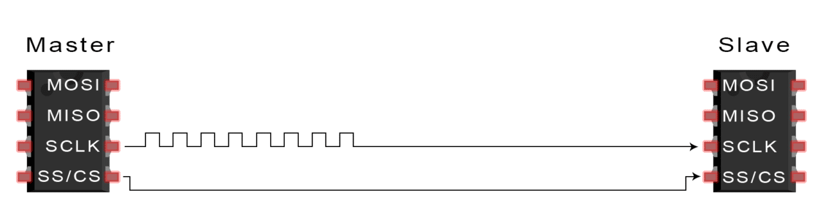
STEPS OF SPI TRANSMISSION
1. The master outputs the clock signal:
The master switches the SS/CS pin to a low voltage state, which activates the slave:

Slide 18


STEPS OF SPI TRANSMISSION (contd..)
The master sends the data one bit at a time to the slave along the MOSI line. The slave reads the bits as they are received:
If a response is needed, the slave returns data one bit at a time to the master along the MISO line. The master reads the bits as they are received:

Slide 19
ADVANTAGES
No start and stop bits, so the data can be streamed continuously without interruption.
No complicated slave addressing system like I2C.
Higher data transfer rate than I2C (almost twice as fast).
Separate MISO and MOSI lines, so data can be sent and received at the same time.

Slide 20
DISADVANTAGES
Uses four wires (I2C and UARTs use two).
No acknowledgement that the data has been successfully received (I2C has this).
No form of error checking like the parity bit in UART.
Only allows for a single master.

Slide 21
THANK YOU !

